Slide 1




Prediction
Ctrl
A reliable tool for analysing and forecasting
Global AI Hackathon
#BuildwithAI : Emergence
#challenge_predictive_algorithm

Slide 2
Problem - COVID 19
Limited knowledge about the growing corona cases
Inadequate management of resources
Non-availability of reliable forecasting tool
Inaccessibility of data derived decision making tool

Slide 3



Solution
VISION : To predict accurately the spread of coronavirus to help businesses and clients to make faster and smarter decision through our tools.
Better decision making
Interactive visualization
Business Integration

Slide 4

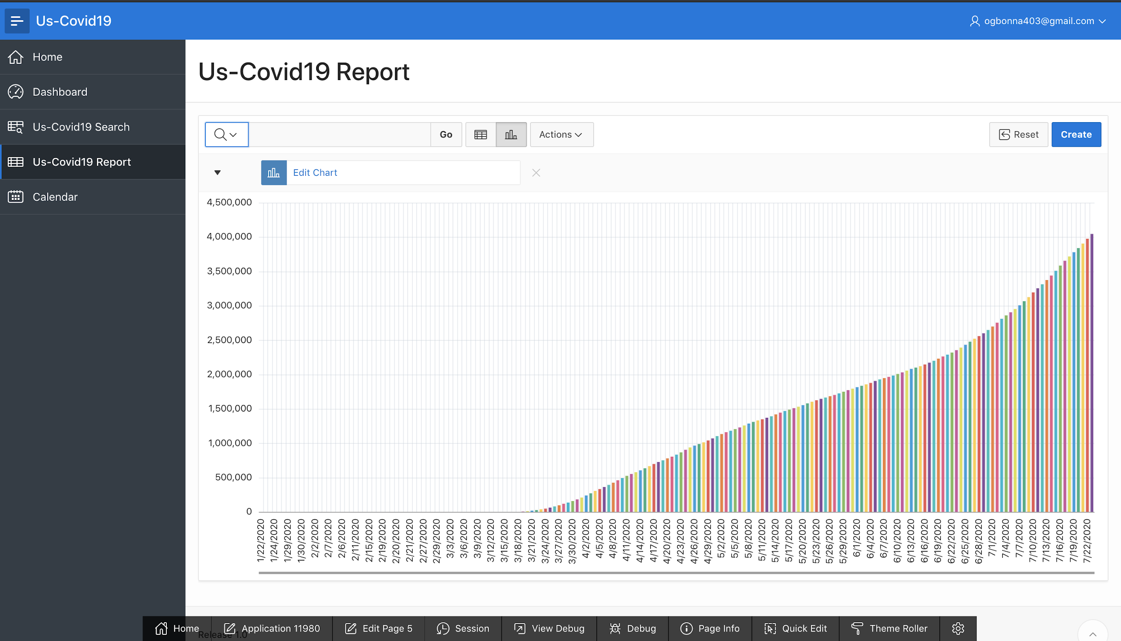
Our Product
Covid-19 Cases Severity
COVID-19 Cases Severeity
Prediction Ctrl
A reliable tool for analysis and forecasting

Slide 5
US COVID-19 Dashboard

Slide 6
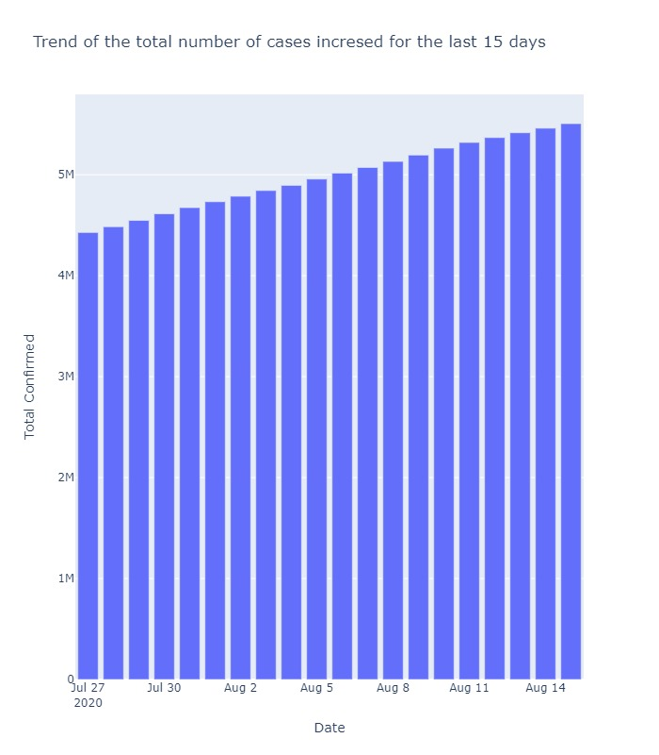
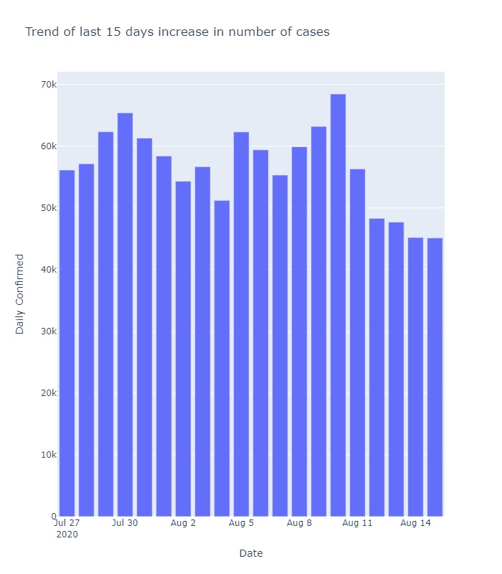
Prediction from July 27th - Aug 15th

Slide 7
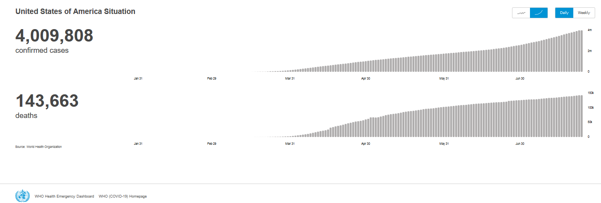
WHO - USA Corona statistics
Source : https://covid19.who.int/region/amro/country/us

Slide 8



Technologies
Oracle Cloud
Amazon Web Service
Google Colab
Oracle Apex/Analytics

Slide 9
Target Market
Other Industries
9.1%
Healthcare & Medical
22.7%
Business services
9.1%
Advertising & Marketing
9.1%
Retail
9.1%
Transportation & Logistics
18.2%
E-commerce
4.5%
Government
4.5%
Startups
9.1%
Source :https://www.goodfirms.co/company/beyond-analysis/focus

Slide 10






Competitive Advantages
Reliable / High Availability Services
Delivered on time
Time / Features Subscriptions
Highly Accurate Results
On-demand Services
Best Price

Slide 11





Competitors
Market Strategy
Partnerships/VCs & Government Funds
Create Public Awareness through marketing
Incentivize user for referral

Slide 12




Business Model
Most popular plan
$25/mon
Monthly subscription
services & Freemium
$299
Additional on-demand services available. (i.e) Customization according to customer preferences.
Plan
Selling SDKs & APIs

Slide 13



Future Roadmap
Next steps is to enhance the model and achieve better accuracy
Market deployment
Product Customization
Expand Market size

Slide 14








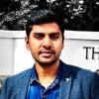
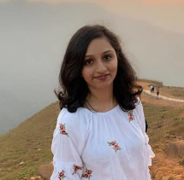



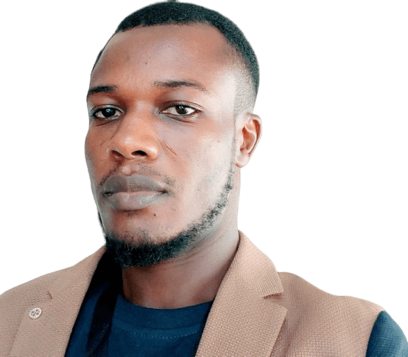
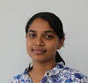



Our Diverse AI Team
Syed Mustafa Imam
Irfan Mansuri
Mahabir Gupta
Dehlia Redker
Lavina
Data Visualizer/ Presenter
Data Analyst & Web Developer
Software Engineer
Lead Mentor
Data Engineer
Franklyn Ogbonna
Tanuj Dhiman
Shenaha Sivakumar
Saif Hague
Software Engineer
Project Manager
GIS & Data Science
Mentor

Slide 15
Thank you
Sponsors
Mentors
Organisers

Slide 16
References
Github link : https://github.com/mahavir9008/Predictive_Algorthim_Challnage
YouTube link : https://www.youtube.com/watch?v=RwUVMNVht2g&feature=youtu.be
Oracle link : https://apex.oracle.com/pls/apex/buildwithai/r/us-covid19/us-covid19-report?session=103878657963762
Username : dummy
Password : buildwithai123

